Slide 1
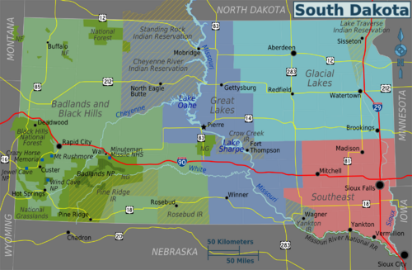
Geologic Resources for the Rosebud Indian Reservation, South Dakota

Slide 2
Geologic Map of South Dakota

Slide 3
South Dakota Stratigraphic Correlation Chart

Slide 4
Hydrology of the Rosebud Indian Reservation, South Dakota (Ellis, Ficken, and Adolphson, 1971)

Slide 5
Elevation Contour Map of the Precambrian Surface of South Dakota (McCormick, 2010)

Slide 6
Precambrian basement terrane of South Dakota (McCormick, 2010)

Slide 7
Cross sections showing geophysical logs of Phanerozoic rocks in South Dakota (Fox, 2009)

Slide 8
South Dakota Geological Survey

Slide 9
South Dakota Geological Survey Online Map Portal

Slide 10
Other Sources Historical hydrocarbon shows Lineaments/satellite imagery Seismic/geophysical data Old reports and maps…

